Slide 1
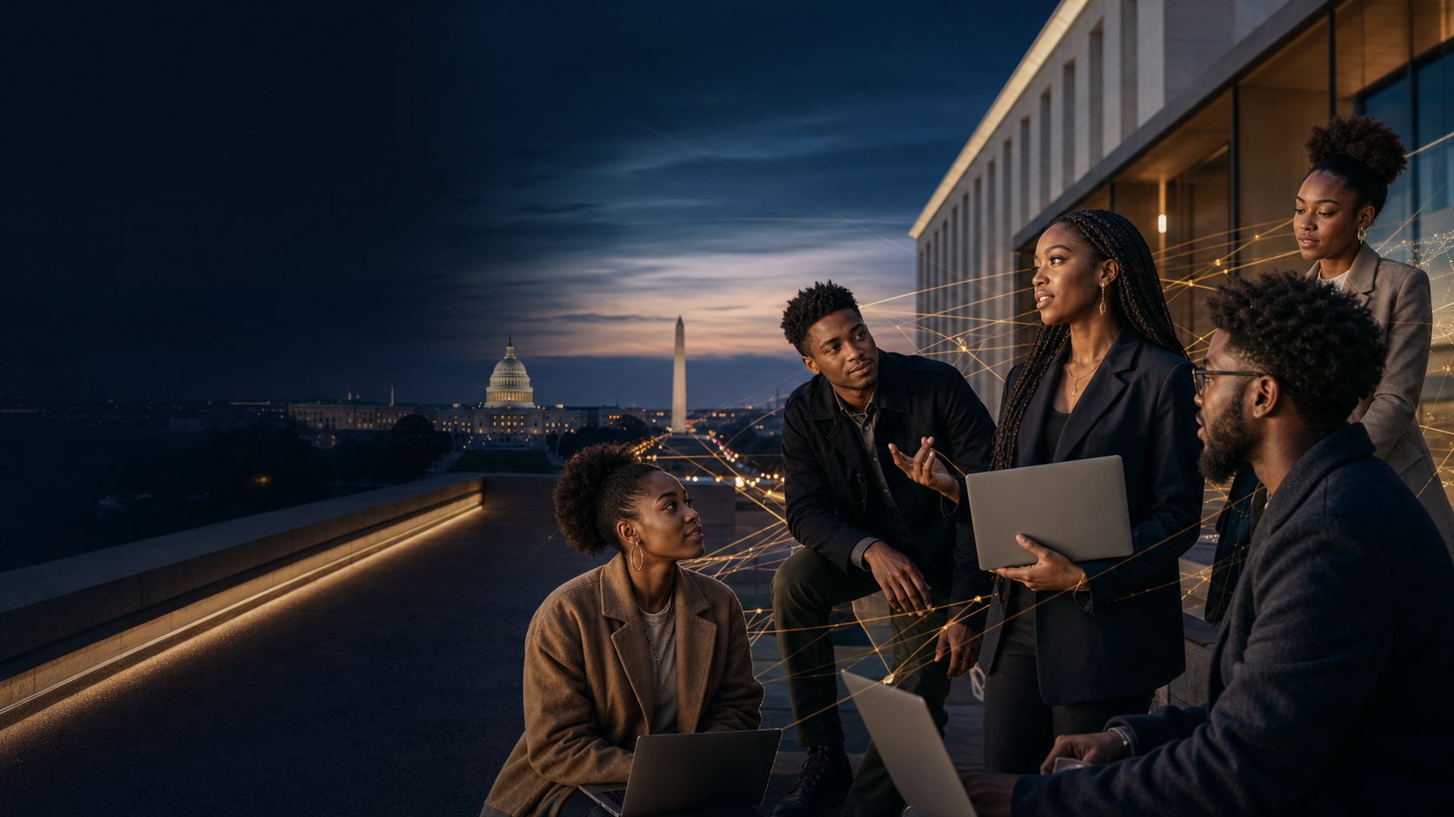

BLACK IN WEB3 TOUR
WASHINGTON, D.C.
SPONSORSHIP OPPORTUNITY
AI • BLOCKCHAIN • OWNERSHIP • HBCU TALENT
A sponsor platform built around access, activation, and measurable community value.
2026 PARTNERSHIP DECK
Notes:
[Sources]
- Original cover artwork generated with OpenAI ImageGen for this deck.
- BlackChain Collective logo supplied by user from existing brand assets.

Slide 2
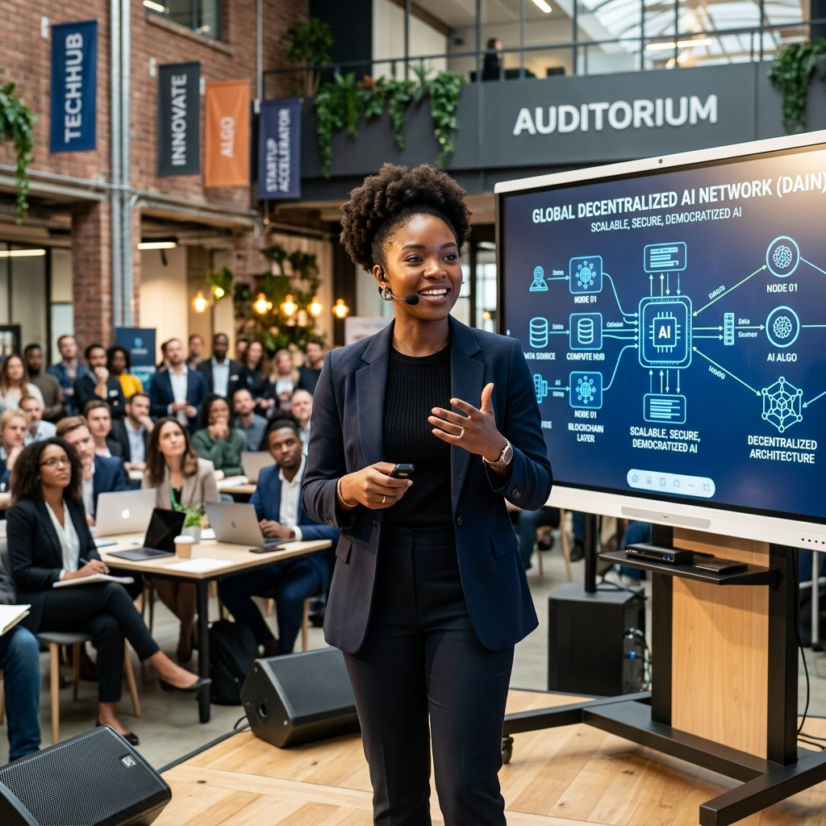
THE MISSION
02
Ownership starts where access becomes infrastructure.
BlackChain Collective connects Black students, founders, creators, investors, and institutions around the systems shaping the next economy.
We turn exposure into practice, practice into opportunity, and opportunity into durable networks.
THE SPONSOR ROLE
Put capital, expertise, tools, and pathways within reach of the people building what comes next.
Notes:
[Sources]
- No external claims; strategy and framing developed for BlackChain Collective.

Slide 3
THE OPPORTUNITY
03
Three gaps keep high-potential talent outside the room.
01
02
03
ACCESS
OWNERSHIP
CONNECTION
Emerging technology moves fast. Many students meet it after the rules and networks are already set.
Learning without capital, IP fluency, or distribution leaves talent skilled but structurally exposed.
One-day inspiration fades. Mentors, hiring pathways, pilots, and founder support make the value compound.
The tour is designed as a conversion engine: curiosity → skill → relationship → opportunity.
Notes:
[Sources]
- No external claims; strategy and framing developed for BlackChain Collective.

Slide 4
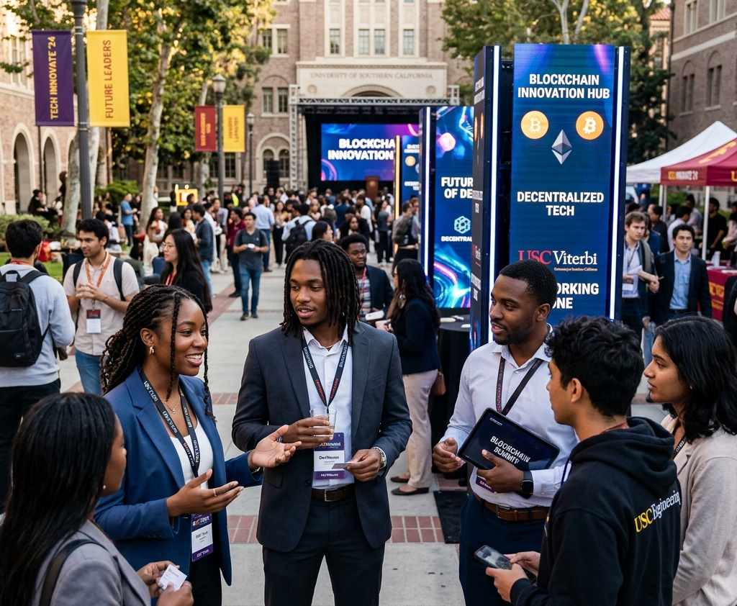
WASHINGTON, D.C. / HOWARD STRATEGY
04
D.C. puts policy, capital, culture, and HBCU talent in one orbit.
01
CAMPUS ENGAGEMENT
Proposed Howard University activation strategy, subject to campus approval and partnership.
02
INSTITUTIONAL ACCESS
Invite technology companies, financial institutions, public-sector leaders, and government contractors.
03
NATIONAL SIGNAL
Use Washington as the launch narrative for an HBCU-centered expansion platform.
Howard University is a strategic target location, not represented here as a confirmed host or partner.
Notes:
[Sources]
- Howard University engagement is presented as a proposed strategy, not a confirmed partnership.

Slide 5
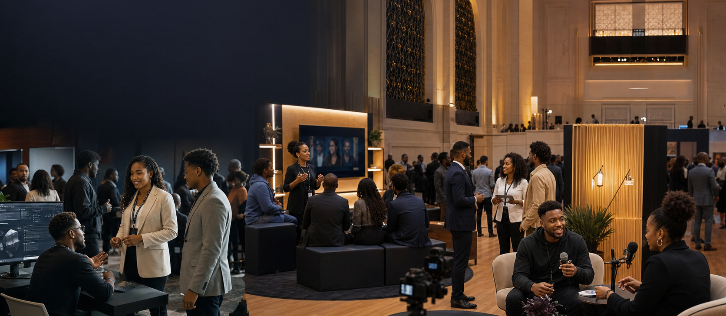
THE EXPERIENCE
05
A live ecosystem, built for movement and human connection.
LEARN
BUILD
CONNECT
SHOW
MOVE
Workshops
Labs + demos
Mentors + peers
Founders + creators
Recruiting + pilots
Notes:
[Sources]
- Original activation artwork generated with OpenAI ImageGen for this deck.

Slide 6
ACTIVATION ZONES
06
Six zones turn sponsor objectives into real experiences.
01
02
03
AI BUILD LAB
WEB3 WALLET LAB
FOUNDER SHOWCASE
Hands-on tools, agents, automation
Safe onboarding, ownership, utility
Demos, feedback, customer discovery
04
05
06
CREATOR STUDIO
TALENT EXCHANGE
INVESTOR LOUNGE
Interviews, content, live storytelling
Recruiting, mentorship, career access
Curated founders, capital, partnerships
Notes:
[Sources]
- No external claims; strategy and framing developed for BlackChain Collective.

Slide 7
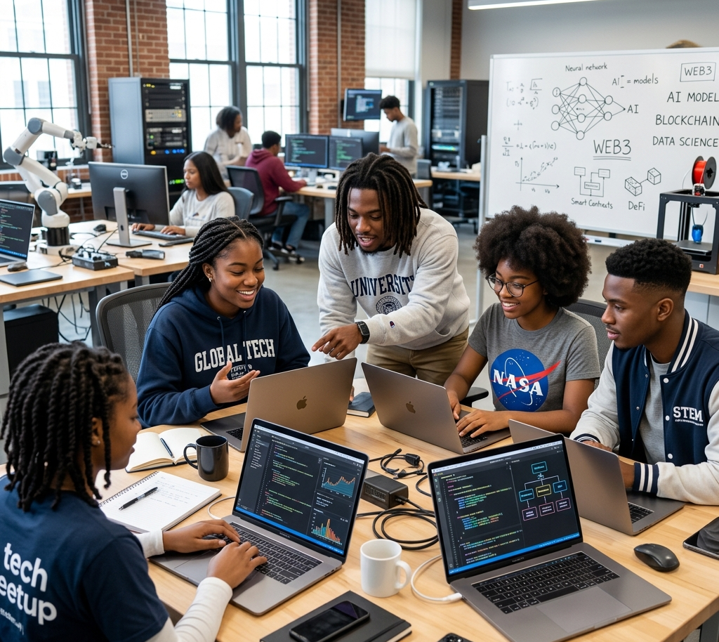
WHO WE ACTIVATE
07
A cross-generational room with talent at the center.
PRIMARY
HBCU students, early-career technologists, founders, creators
ECOSYSTEM
Corporate innovators, recruiters, investors, mentors, public-sector leaders
COMMUNITY
Educators, nonprofit partners, local builders, media, alumni
Attendance, demographic, and reach targets will be finalized with venue, campus, and media partners.
Notes:
[Sources]
- No external claims; strategy and framing developed for BlackChain Collective.

Slide 8
SPONSOR ROI
08
Every partnership should create value people can point to.
01
TALENT
Recruiting access, mentor touchpoints, skills visibility
02
BRAND
Integrated presence inside useful, trusted experiences
03
CONTENT
Interviews, demonstrations, recap assets, founder stories
04
INNOVATION
Pilots, product feedback, ecosystem intelligence
05
COMMUNITY
Scholarships, stipends, tools, and durable local capacity
We build the measurement plan before launch, then report what happened, what moved, and what comes next.
Notes:
[Sources]
- No external claims; strategy and framing developed for BlackChain Collective.

Slide 9
MEASUREMENT
09
The scorecard connects sponsor goals to observable outcomes.
REACH
ENGAGEMENT
PATHWAYS
EQUITY
Registrations
Attendance
Content views
Workshop participation
Demo interactions
Mentor connections
Interviews
Applications
Pilots / follow-ups
Scholarships
Stipends
Tools distributed
MEASUREMENT PRINCIPLE
Targets are co-designed. Results are reported as actuals. No vanity math, no inflated reach, no fog.
Notes:
[Sources]
- No external claims; strategy and framing developed for BlackChain Collective.

Slide 10
BUDGET ALIGNMENT
10
The first $30K funds the room. The next dollars build continuity.
TRAVEL
$3.5K
MARKETING
$3.0K
$30K
LODGING
$4.0K
TECHNOLOGY
$2.5K
Preferred event budget
VENUE
$2.5K
PROGRAMMING
$2.0K
$15K–$25K
In-kind target
FOOD
$2.0K
STUDENT EXPERIENCE
$2.5K
$75K–$100K
MERCHANDISE
$4.0K
CONTINGENCY
$3.0K
Full ecosystem launch
Budget source: existing Black In Web3 DC Activation Budget. Figures are planning estimates.
Notes:
[Sources]
- Black In Web3 Tour Washington, D.C. Activation Budget, supplied by user.

Slide 11
PARTNERSHIP ARCHITECTURE
11
Four cash tiers, one rule: every dollar has a job.
$25K
$50K
$75K
$100K+
COMMUNITY PARTNER
INNOVATION PARTNER
PRESENTING PARTNER
FOUNDING PARTNER
Fund a core experience
Own a high-value activation
Lead the D.C. experience
Launch the platform beyond one day
Activation + visibility
Category-aligned benefits
Measurement plan
Activation + visibility
Custom title rights and category exclusivity are negotiated separately.
Notes:
[Sources]
- No external claims; strategy and framing developed for BlackChain Collective.

Slide 12
$25K / $50K
12
Fund the experience people touch, remember, and share.
$25K COMMUNITY PARTNER
$50K INNOVATION PARTNER
•
Named support of one activation zone
•
Lead ownership of a signature zone
•
Integrated event + digital visibility
•
Curated workshop, demo, or challenge
•
Employee mentor or speaker pathway
•
Expanded talent + founder engagement
•
Post-event impact brief
•
Co-produced content package
•
Option to fund scholarships or access
•
Priority measurement and follow-up design
Notes:
[Sources]
- No external claims; strategy and framing developed for BlackChain Collective.

Slide 13
$75K / $100K+
13
Launch D.C. strong, then build the infrastructure that survives it.
$75K PRESENTING PARTNER
$100K+ FOUNDING PARTNER
01 Top-tier D.C. positioning
D.C. activation + platform capacity
02 Multiple branded experiences
• BlackChain infrastructure
• Curriculum development
03 Executive visibility + curated convening
• Student ambassador program
04 Expanded content and reporting
• Website + CRM
• DePIN pilot
• Additional HBCU expansion planning
Deliverables, timing, exclusivity, and geographic rights are finalized in the partner scope.
Notes:
[Sources]
- Full ecosystem uses listed in the supplied activation budget.

Slide 14
IN-KIND PARTNERS
14
Donated infrastructure protects cash for talent and programming.
VENUE + AV
TRAVEL + LODGING
Campus or event venue, production, screens, sound
Air, rail, hotel rooms, ground transportation
FOOD + HOSPITALITY
MEDIA + CONTENT
Catering, speaker hospitality, refreshments
Photography, video, livestream, press support
MERCH + PRINT
CONNECTIVITY + TOOLS
NFC goods, signage, badges, collateral
Internet, cloud credits, devices, software
TARGET VALUE $15K–$25K
Notes:
[Sources]
- In-kind target from the supplied activation budget.

Slide 15
NATIONAL EXPANSION
15
D.C. is the proof point. The system is designed to travel.
01
02
03
04
PROVE
REPEAT
NETWORK
COMPOUND
Washington, D.C.
HBCU market clusters
Multi-campus platform
National ecosystem
Validate experience, partner value, and reporting
Adapt the operating playbook with campus partners
Connect ambassadors, founders, mentors, and sponsors
Curriculum, capital pathways, pilots, and owned media
Expansion locations remain opportunity targets until campus and local partners are confirmed.
Notes:
[Sources]
- No external claims; strategy and framing developed for BlackChain Collective.

Slide 16
WHO FITS
16
We want partners with resources, patience, and a real pathway to opportunity.
AI + CLOUD
WEB3 + DIGITAL ASSETS
BANKING + PAYMENTS
Tools, credits, developer ecosystems
Ownership, infrastructure, education
Financial inclusion, entrepreneurship
CYBER + GOVTECH
MEDIA + CREATOR TECH
FOUNDATIONS + GRANTMAKERS
Workforce, resilience, public-sector access
Distribution, storytelling, production
Education, mobility, digital equity
Priority cash range: $25K–$100K+ • Foundation opportunities: up to $250K • Evidence status: Verified / Estimated / Unknown
Notes:
[Sources]
- Research structure reflects the user's prior sponsorship research direction.

Slide 17
CALL TO ACTION
17
BUILD THE ROOM.
BACK THE TALENT.
OWN THE OUTCOME.
Choose a partnership tier, align it to an activation, and co-design the scorecard before launch.
NEXT STEP
Schedule a sponsor design session
BLACKCHAIN COLLECTIVE • BLACK IN WEB3 TOUR • WASHINGTON, D.C.
Notes:
[Sources]
- Original cover artwork generated with OpenAI ImageGen for this deck.
- BlackChain Collective logo supplied by user from existing brand assets.

